Slide 1
Subscription based E-Commerce Web Application
‘BlueApron’
Team: Hunters

Slide 2
Our Team
Sagar Patil
Aamena Suzzanne
Sanjyot Kotgire
Harshit Gangwar
Shruti Jha
Abhinav Kumar
Sanika Ganguly
Manish
Samiksha Wajage

Slide 3
Idea Brief
‘BlueApron’ is an innovative platform that connects food lovers with curated meal plans and subscription services.
‘BlueApron’ ensures a seamless journey from selecting meals to receiving them at your doorstep, enhancing your lifestyle with healthy, delicious, and customized food solutions.

Slide 4
Key Features
Explore Diverse Cuisines Discover a variety of meal options tailored to your tastes
Subscription Plans for Every Lifestyle Choose flexible subscription plans that fit your dietary needs
User-Friendly Interface Easy-to-navigate subscribing, secure and seamless payments
Access to Exclusive Recipes Unlock a collection of curated recipes to try at home, inspired by your favorite meals.
Manage Orders and Subscriptions Easily manage, modify, or cancel subscriptions and view order history.

Slide 5
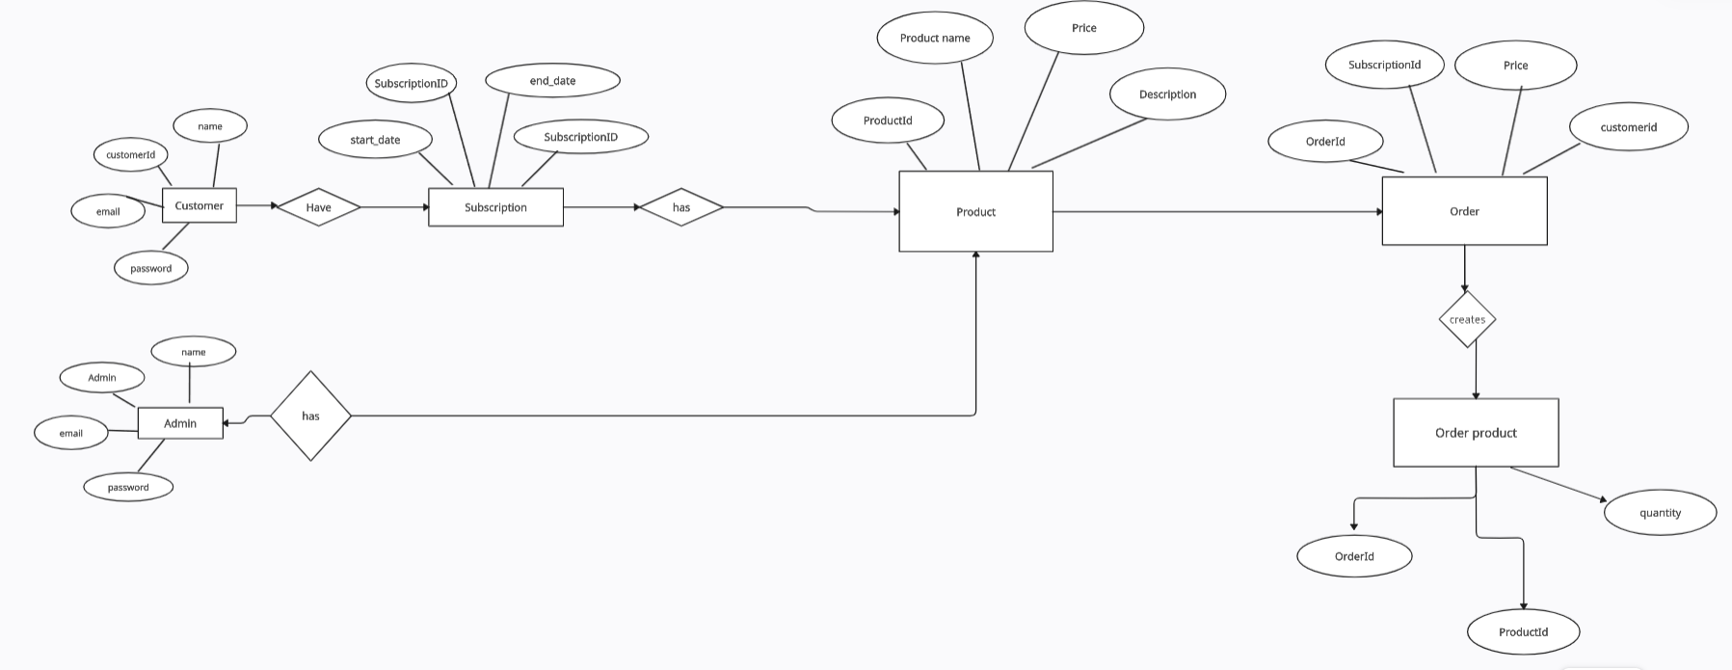
ER Diagram

Slide 6
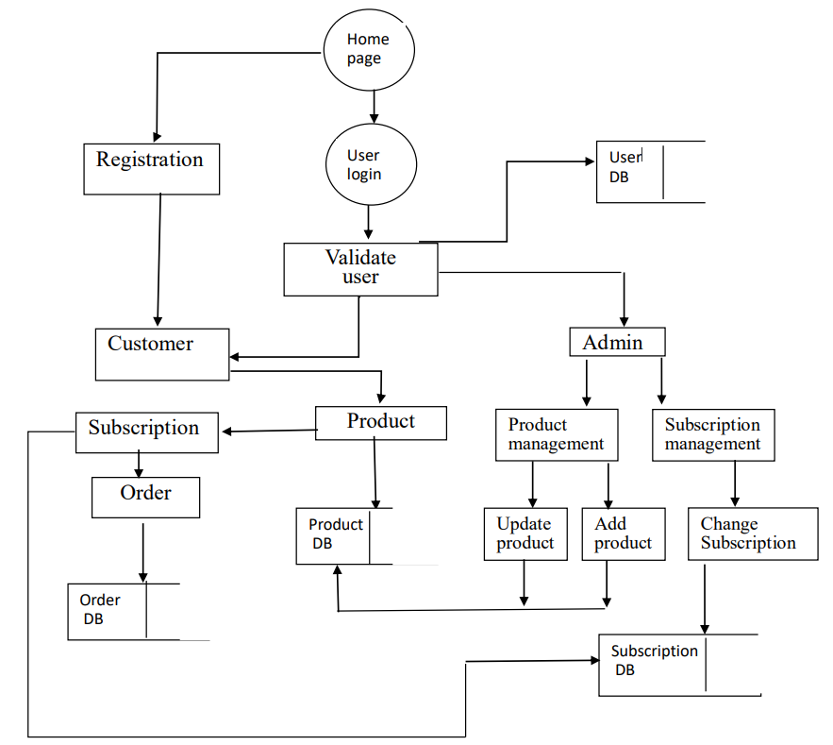
Use Case Diagram

Slide 7







Team Learnings
JS
JUnit
HTML
CSS
GIT
GITHUB
JAVA

Slide 8
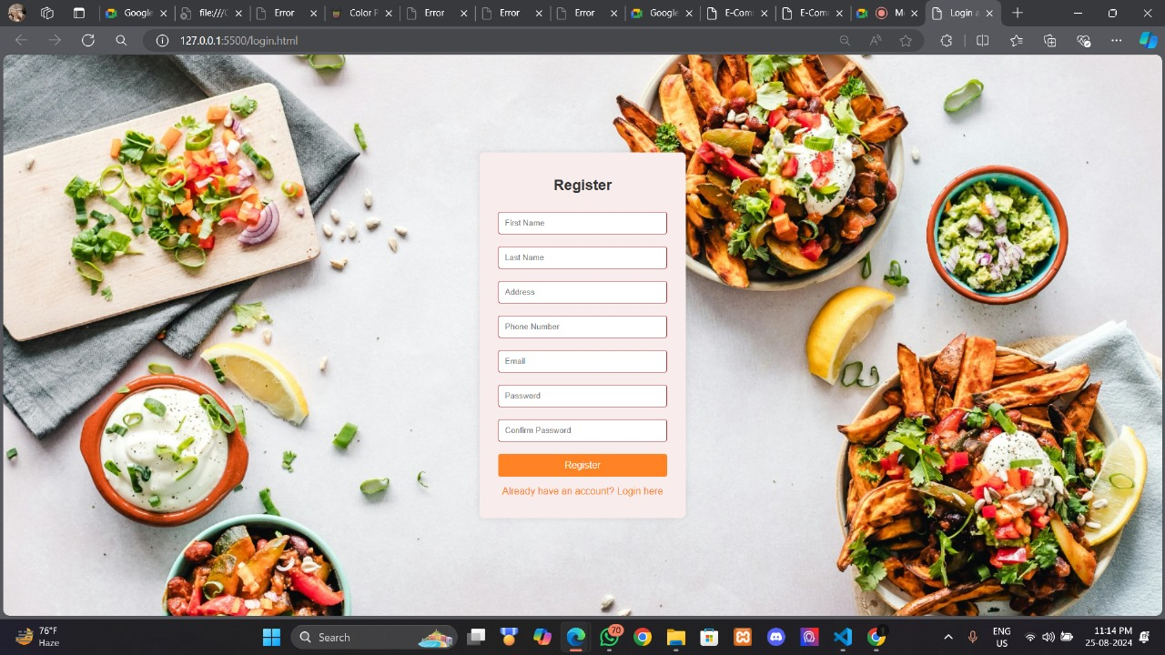
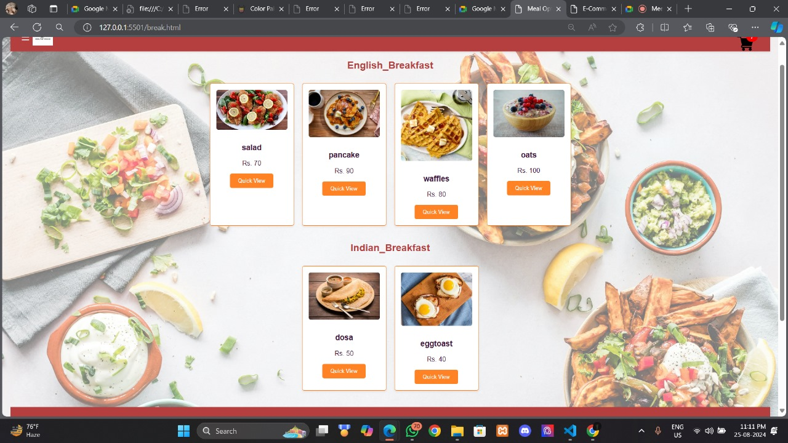
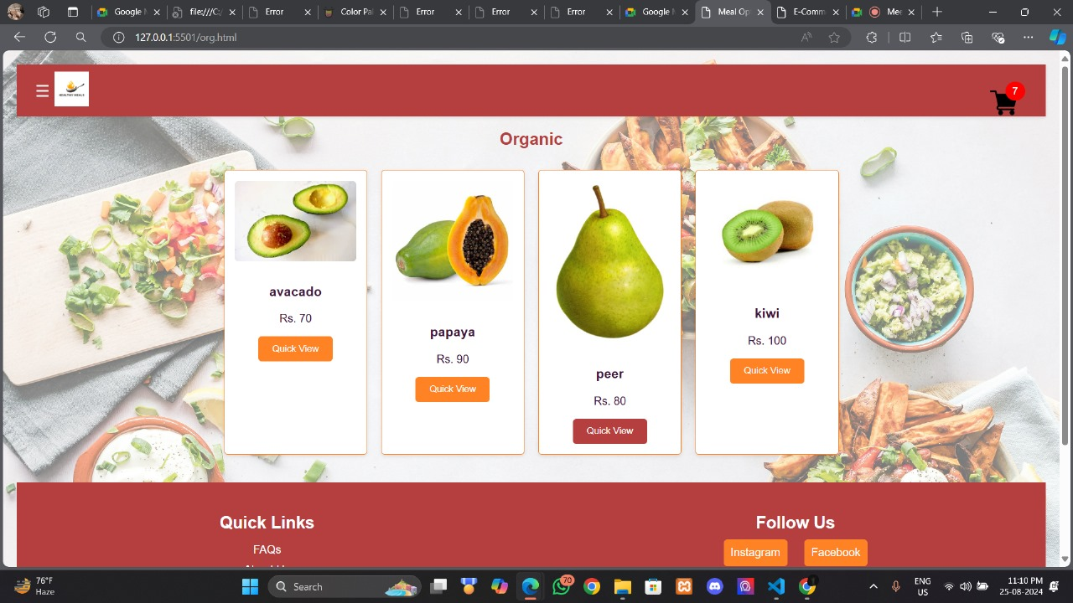
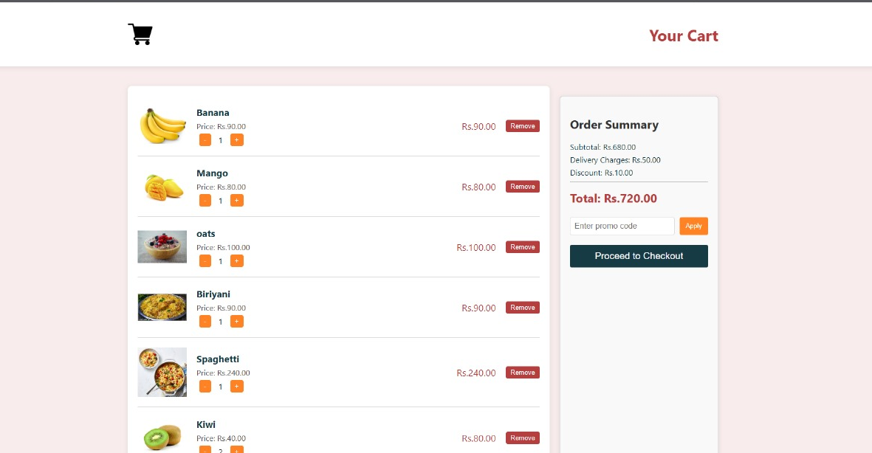

Slide 9
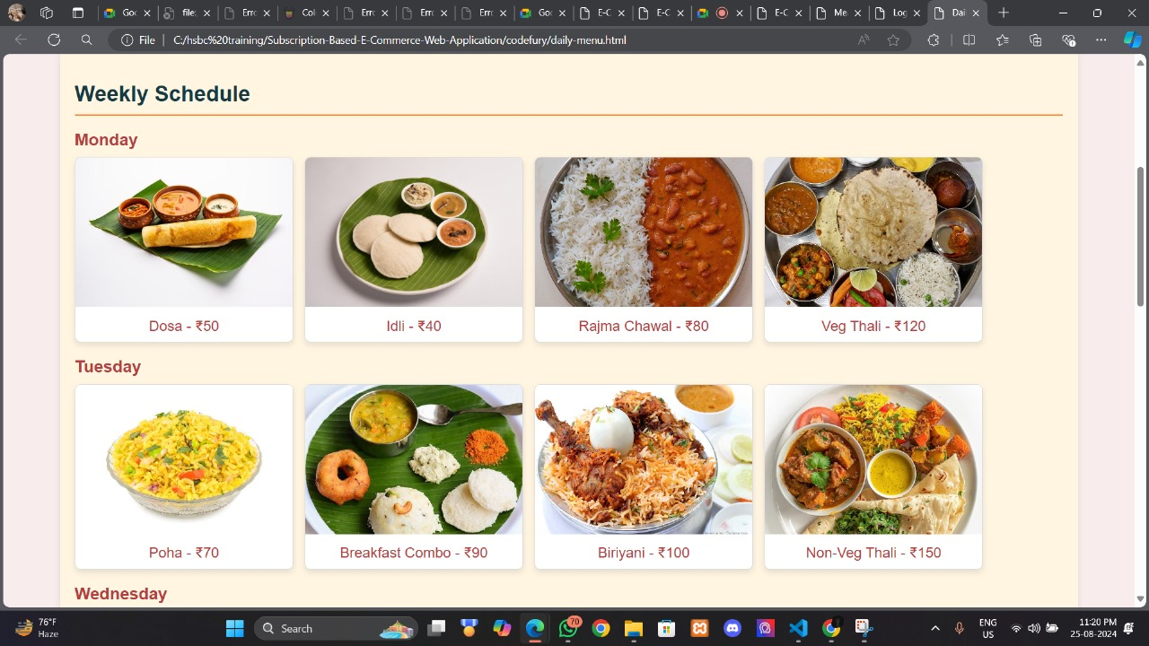
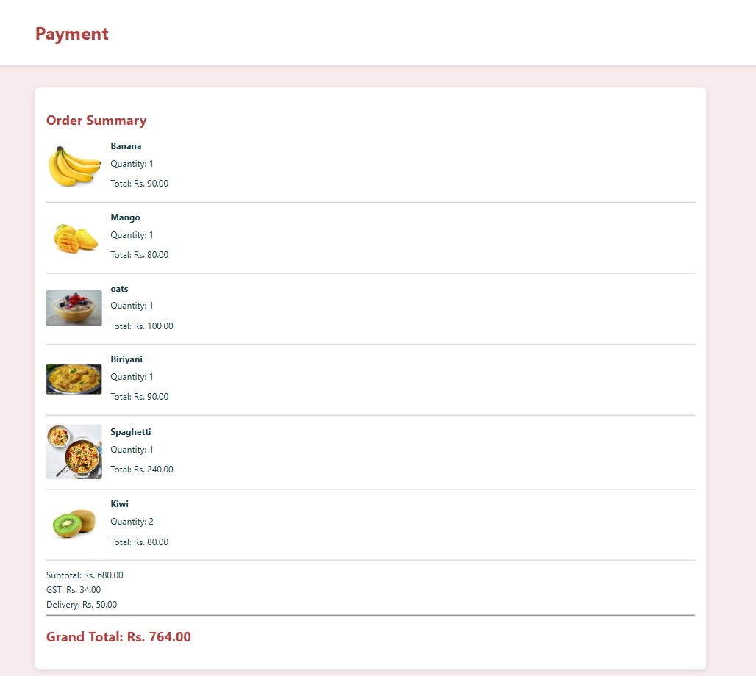
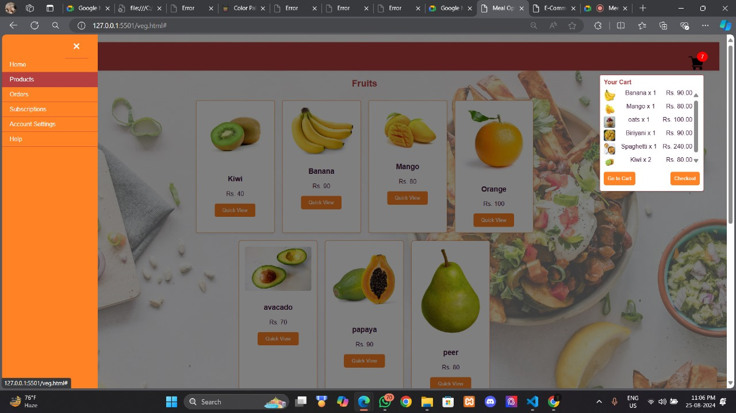

Slide 10
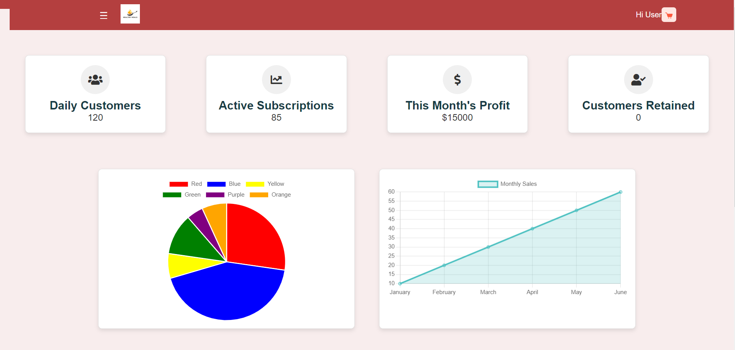
DashBoard

Slide 11
Thank you

Slide 12
Any Questions

